Slide 1
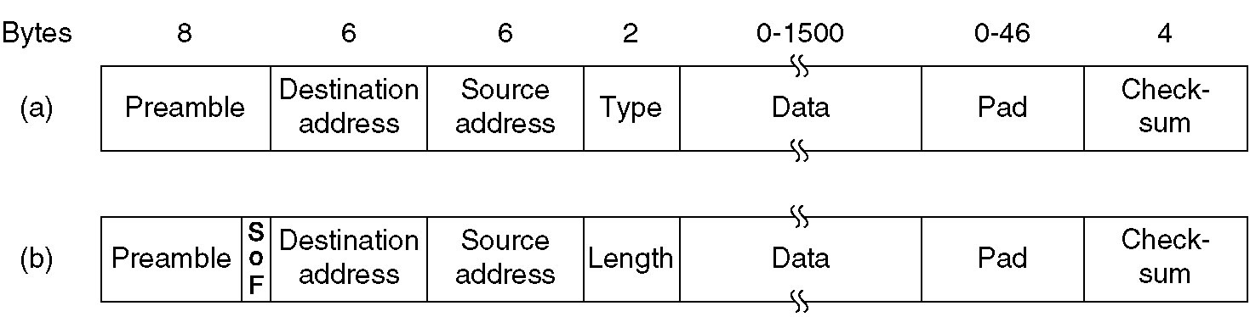
DIX Ethernet and IEEE 802.3 Frame Structures
Frame formats. (a) DIX Ethernet, (b) IEEE 802.3.

Slide 2
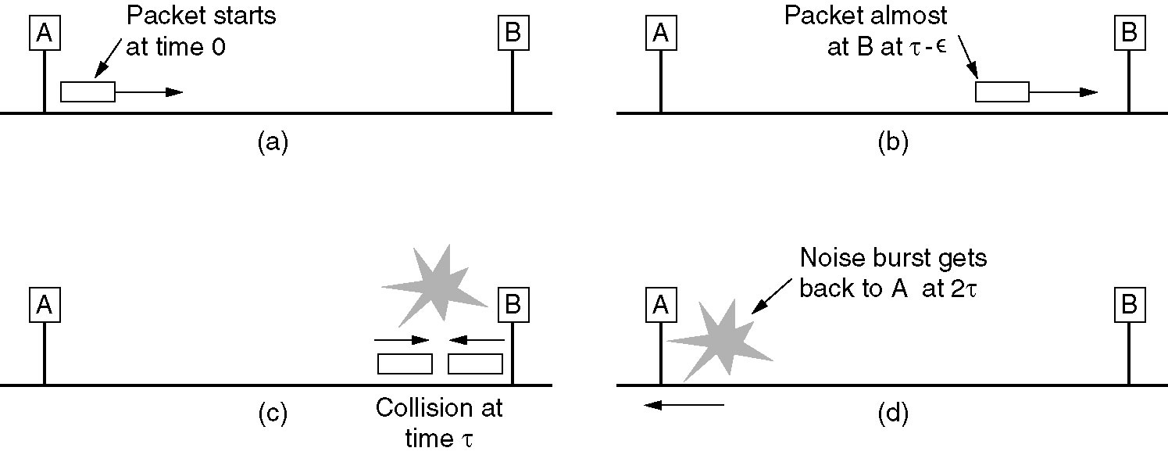
Minimum DIX Frame Size Rationale

Slide 3
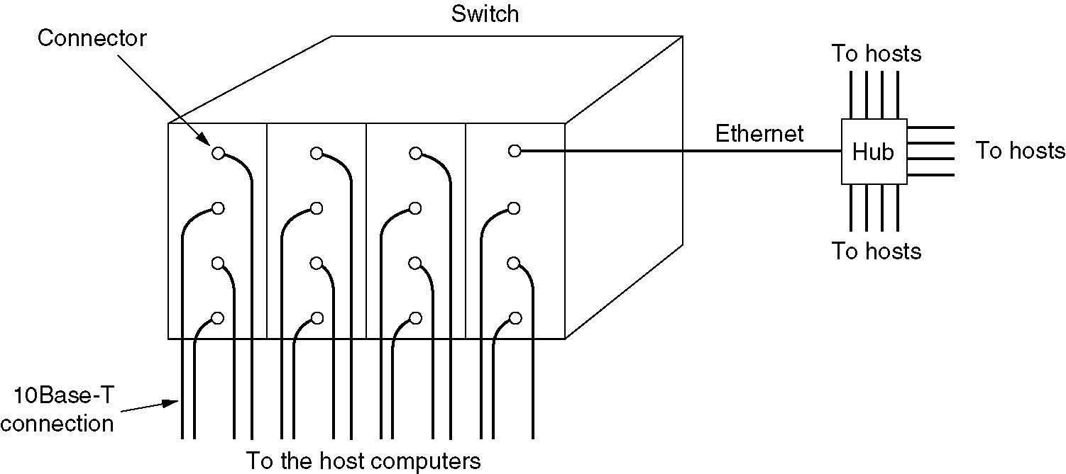
Switched Ethernet
Switch composition
  Contains a high-speed backplane
  Contains capacity for 4-32 plug-in line cards
    Each plug-in line cards contains 1-8 connectors
    Connectors are typically 10Base-T twisted pair to a single host computer
A simple example of
switched Ethernet.

Slide 4
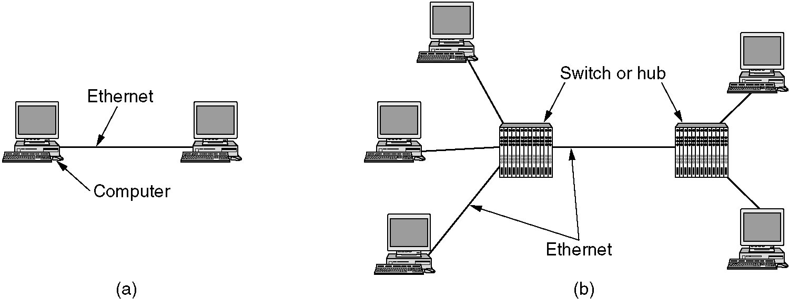
Gigabit Ethernet
(a) A two-station Ethernet. (b) A multistation Ethernet.

Slide 5
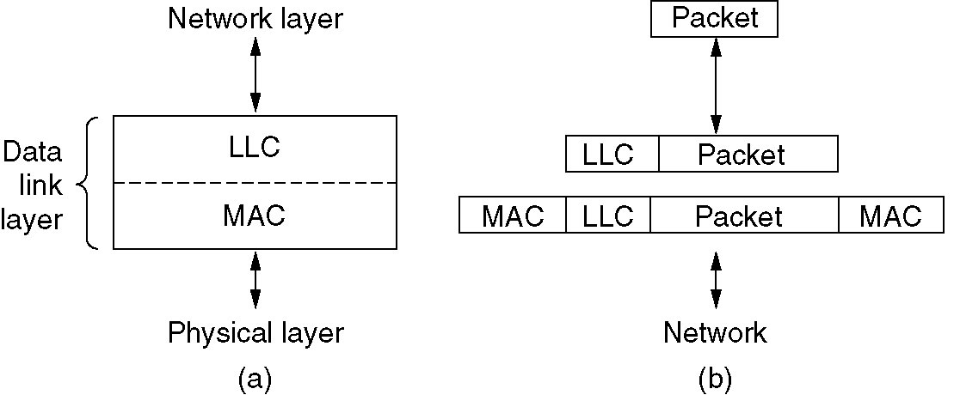
IEEE 802.2: Logical Link Control
(a) Position of LLC. (b) Protocol formats.

